Slide 1
App User Behavior Segmentation
G.Vidhya

Slide 2
Problem Statement
Modern apps have thousands of users
Difficult to understand user behavior manually
Need to segment users based on activity

Slide 3
Project Objectives
Segment users into meaningful groups
Identify:
High engagement users
Low engagement users
At-risk users
Support business decisions using data

Slide 4
Dataset Overview
Dataset contains user activity data
Number of records:50000
Important Features:
sessions_per_week
daily_active_minutes
engagement_score
churn_risk_score
feature_clicks_per_session

Slide 5
Data Preprocessing
Removed unnecessary columns:
user_id
app_version
Handled missing values
Selected important features for clustering

Slide 6
Feature Scaling
Applied StandardScaler
Ensures all features are on same scale
Why important?
Clustering is distance-based
Prevents bias from large values

Slide 7
K-Means Clustering
Applied K-Means clustering
Number of clusters: 4
Steps:
Initialize centroids
Assign points
Update centroids
Repeat until convergence

Slide 8
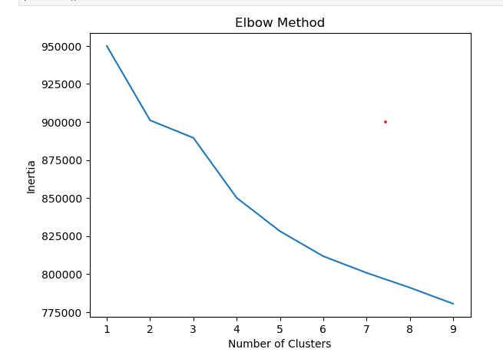
Elbow Method
Used Elbow Method to find optimal clusters
Selected K = 4

Slide 9
Cluster Results (KMeans)
Users divided into 4 clusters
Categories assigned:
High Users
Moderate Users
Low Users
Occasional Users

Slide 10
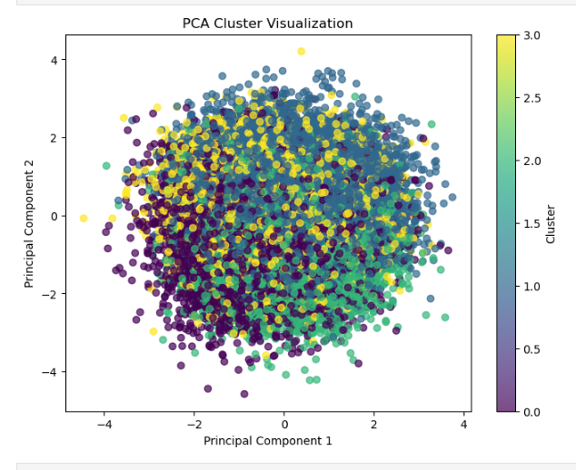
PCA Visualization
Used Principal Component Analysis
Purpose:
Reduce dimensions
Visualize clusters in 2D

Slide 11
Cluster Evaluation
Used Silhouette Score
Result:
Score ≈ 0.04
Interpretation:
Clusters are weak
Users have similar behavior

Slide 12
DBSCAN Clustering
Applied DBSCAN
Result:
All points labeled as -1 (noise)
Conclusion:
No dense clusters found
User behavior is evenly distributed

Slide 13
Key Insights
Users show similar engagement patterns
No strong separation between groups
Clustering still helps in segmentation

Slide 14
Business Insights
Identify high-value users for loyalty programs
Detect at-risk users for retention
Improve engagement strategies

Slide 15
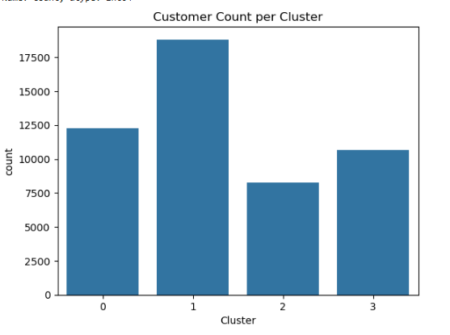
Analytical Task

Slide 16
User_Category
Low Users 18806
Moderate Users 12283
High Users 10663
Occasional Users 8248

Slide 17
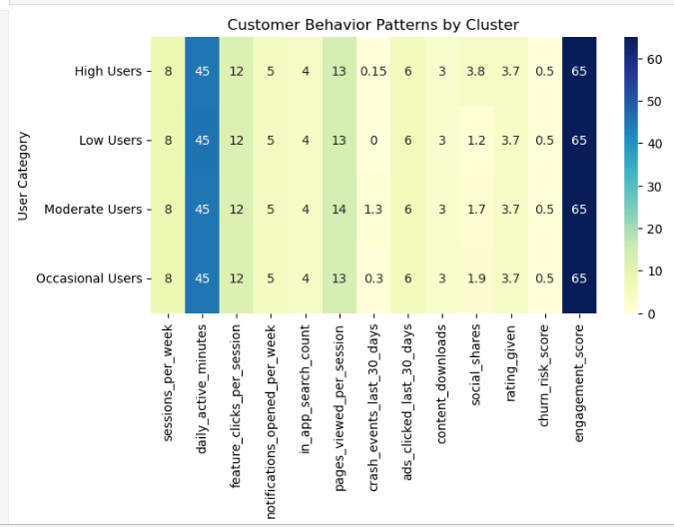

Slide 18
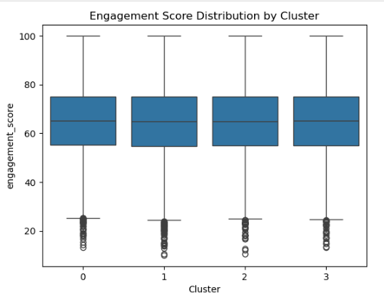

Slide 19
Similar engagement across all clusters
Spread (variation) is also similar
Presence of low outliers in all clusters

Slide 20
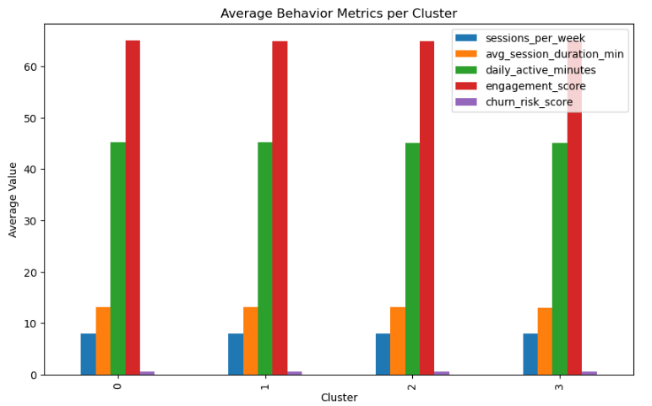
Behavior Analysis

Slide 21
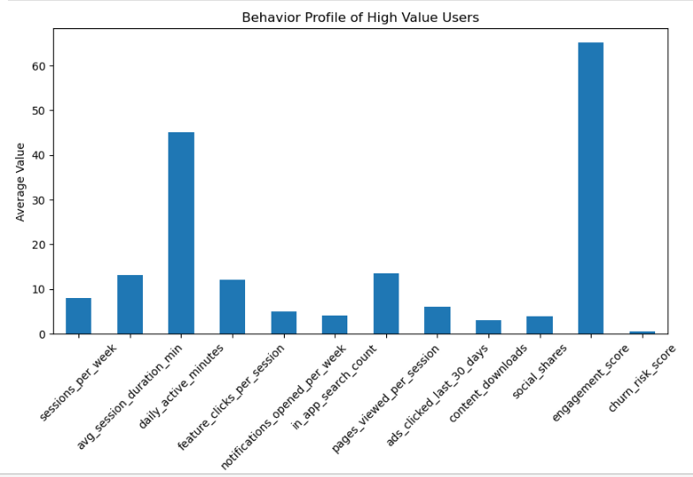
High Value User

Slide 22
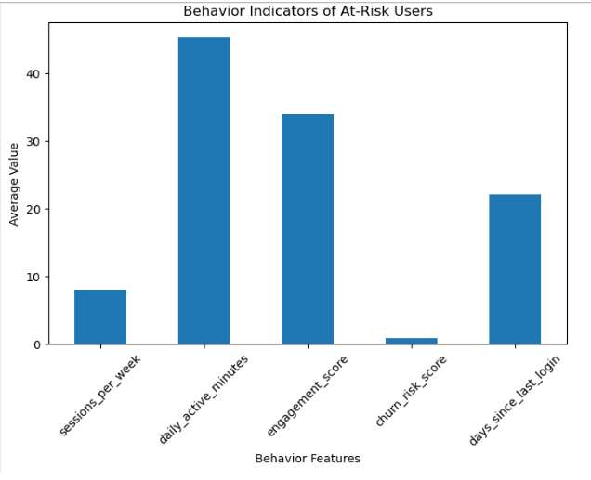
Risk User

Slide 23
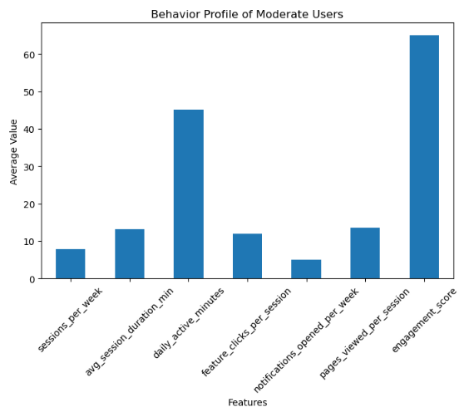
Moderate User

Slide 24
Conclusion
Clustering helps understand user behavior
Kmeans worked for this dataset
DBSCAN not suitable for this dataset

Slide 25
Thank You

